Slide 1
Chapter 7. Description of Major Vegetable Crops
  7.1. Solanaceae Vegetables:
  Solanaceous vegetable include several fruit plants of family solanaceae and genera solanum eg.
      Tomato, potato, eggplant, pepper.
  These crops have similar method of culture

Slide 2
A. Tomato (Lycopersicon esculentum Mill)
Origin, Taxonomy and Botany
Originated in Peru, Ecuador or Bolivia (South America)
Belongs to the family: - Solanaceae (night shade family), Genus: - lycopersicon, and species: esculentum
The tomato cultivars currently produced in Ethiopia vary in growth habit such as determinate (0.9 - 1.2 m), semi-determinate and indeterminate (2.1 -4.5 m)

Slide 3
Tomato is An annual, but the same plants can be harvested for several years.
Stems are round, soft and hairy - young
The shape of fruit differs from one variety to the other &
Also the color of fruits ranges from yellow to red

Slide 4
Use of tomatoes
The most important vegetable crop worldwide next to Potato b/se:
  It is economically attractive and can contribute to a healthy, for well-balanced diet
Consumed as
  fresh in raw/salads in combination with leafy vegetables, green onions, cucumbers, peppers & other vegetables or
  cooked & Often added to sandwiches or hamburgers

Slide 5
It is also used as a processing crop that takes first rank among the vegetables;
  Processed into different forms (ketchup, sauce, juice, canned and dried)
Important sources of lycopene/beta carotene and vitamin C and are valued for their color and flavor & minerals, organic acid , sugar etc…
It is regard as one of the most “protective food”.
  B/C of its special nutritional value & widespread production.

Slide 6
It is an important cash/income-generating crop to small-scale farmers and provides employment
  in the production and
  processing industries.
Relatively short duration vegetable crop with High economic value and
High in micronutrient content

Slide 7
Cultivars:
  Tomato cultivars range widely
      in fruit shape, size, color, and
      plant type, disease resistance,
      processing characteristics ripening time,
      flesh thickness,
      number of locales,
      fruit quality (TSS%, pH, acidity, juice volume, flavor, nutritive values etc)

Slide 8
    (1) Fresh market cultivars:
      having fruits of
        firm, smooth, red skin well colored, acceptable flavor, round, large, free from defects, good keeping quality & high vitamins content are the most preferred in local markets.
    (2) Processing cultivars –
      High TSS %(4.5 - 6.0) is responsible for high yield of processed products, intensive red colors of skin & flesh, low acid content (pH >4.5),
      better tolerant to diseases & physical damages are some of the attributes favored by processing industries

Slide 9
Varieties released Ethiopia
Table 1. Average seed yield & some other characters of Tomato variety
Source: Melkassa Agricultural research center

Slide 10
Table 2. Characteristics of released/recommended cultivars
Source: Melkassa Agricultural research center

Slide 11
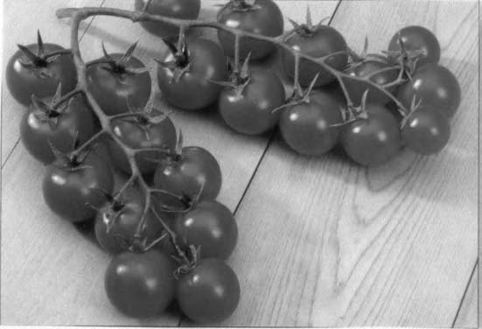
FIGURE : Vine-ripened fruit attached to the truss stem known as tomato-on-the-vine (TOV).

Slide 12
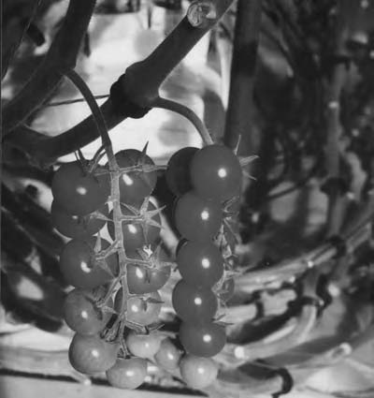
Cherry tomato fruit-on-the-vine

Slide 13
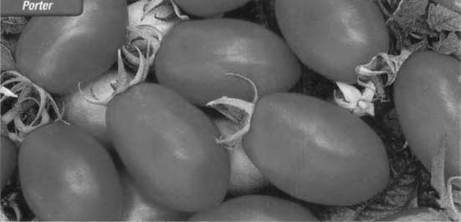
FIGURE : Plum-shaped or Roma tomato fruit.

Slide 14
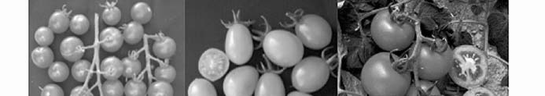
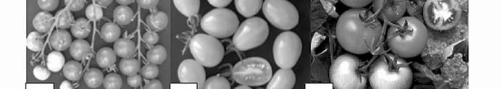
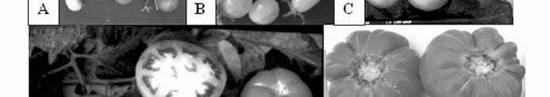
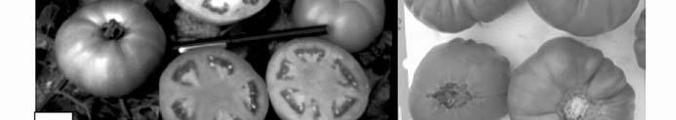
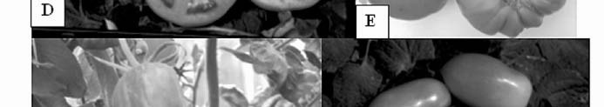
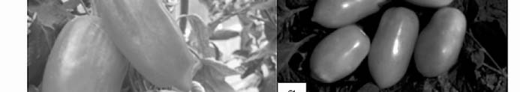

Slide 15
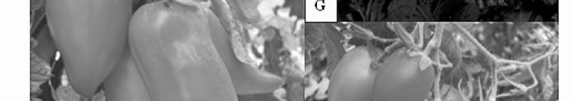
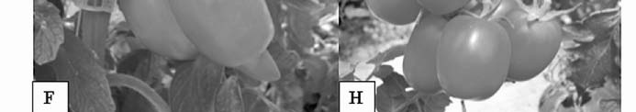
Fig. Different fruit types of tomato. A) Cherry, B) Cocktail pear-shaped, C) Canary for cluster harvesting, D) Beefsteak, E) Marmande, F) Pepper, G) tomato for processing, long pear shaped and H) tomato for processing, square shaped.

Slide 16
Types of tomato based on growth habit
Indeterminate (2.1- 4.5m)
  The terminal bud or the stem remains vegetative and will continue to after flowering .
  Flower clusters are formed after every three leaves.
  Plants can grow almost indefinitely and consequently
  Tend to be much taller than determinates.
  Open or rangy in growth & produce fruits for extended period

Slide 17
  Have higher labor req’t for maintenance & stacking (need support )
  Produce fruits for extended period & high fruit yield
  Slower ripening and
  have high leaf/fruit ratio;
  e.G. Marglobe, moneymaker, better boy, floradel, big beef etc

Slide 18
Determinate (0.9 - 1.2m)
  Bush, compact like, short and fruit mature in a relatively short time as compared to indeterminate ones.
  The growing point in the axil of the last-formed leaf transforms into a flower cluster, after which vegetative growth on that stein ceases (stop growing after flowering)
  Flower clusters are formed about every two leaves.
  They have a relatively concentrated fruit set; 3-8 fruits produced per cluster

Slide 19
  It is favorable for concentrated fruits production for early market (b/c fruits ripen much faster and uniformly) and are suitable for processing industries (b/c of having high TSS)
  Are not heavily pruned
  e.G. Roma VF, napoli, ventura, celebrity, mountain pride, pearson and others). Stacking to support the plant may not be necessary
Semi-determinate-
    The height is found b/n the two types

Slide 20
Climatic and soil requirements
The tomato is a warm-season crop.
It requires dry climate for high yield and premium quality.
Rain free, clean dry warm conditions & moderately uniform T°C are favorable for high fruit set, clean fruits, less disease incidence & for high quality fruit production.
Temperature
  Fruit setting may not occur if the T°C is too high or too low if its happens during flowering pollen production time (production is to low)

Slide 21
  Comparatively cool nights with T°C of 15-20°C & warm day T°C b/n 21 and 24°C are best for optimum yields.
  Plant tissues are damaged below 10 ºC and above 38 ºC.
  Frost also will kill the plant.
Light requirements –
  Light intensity affects the color of leaves & fruit & fruit set. It is very important in ascorbic acid & carotene content.
  High light intensity accompanied by high T°C is harmful to fruit set

Slide 22
Water and humidity- water stress and long dry periods will cause:
    Buds and flowers to drop off and Fruits split
  Too heavy RF & humidity increase mold growth & fruit will rot. Cloudy skies will slow down the ripening of tomatoes.
  Tomato plant produce large yield under irrigation in semi arid and arid regions
  High RH affect pollen dispersal

Slide 23
Soil
  It prefers deep (15-20cm), well drained, good WHC & free of salt & sandy loam is considered best.
  Tomatoes can be grown on almost all soil types from sandy to heavy clay, at a pH range b/n 5.5-6.5 (slightly acidic)
Altitude: cultivated at an altitude 700-2000 ma.s.l.

Slide 24
Sowing seeds in nursery-
  Seeds are sown in well prepared bed in nursery at a spacing of 10-15cm between rows at 0.5-1 cm depth & well decomposed FYM or 100g of urea per 5m².
  Mulching material: dry grass for 10 days
  Seeding rate: 300-350g (95% germination).
  Other nursery management practices is applied

Slide 25
Stage of transplanting:
  Seeding of
    13-15 cm height or
    3 to 4 true leaves stage or
    28-35days old are ready for transplanting.
  Before uprooting seedlings for transplanting purpose; seedlings must be passed through hardening off process

Slide 26
Cultural practice
Land preparation: well-prepared soil, fertile and leveled, not used for related crops in the last 2-3 seasons.
Spacing - seedlings are transplanted to main field at spacing of 70 cm b/n rows & 30 cm b/n plants in Ethiopia
Fertilizer/manuring: 200 kg/ha DAP & 150 kg/ha Urea, 50% of urea at time of transplanting and the other 50% a half moths after transplanting.

Slide 27
Pruning: pruning of axillary shoots is usual practice for staked; it is done for indeterminate types.
  Advantages; increase fruit quality, large fruit size, early fruit and convenient for harvesting.
  Disadvantage; more labor is required, limit plant growth, fruit will be more liable to sunscald and reduce total yield.

Slide 28
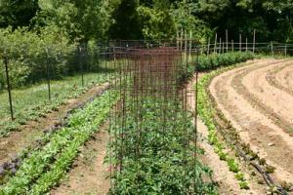
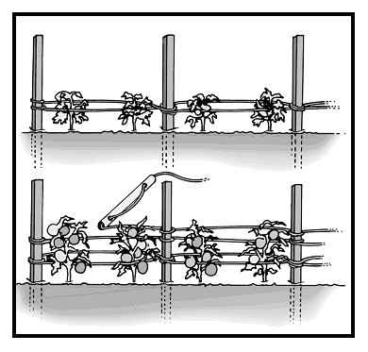
Staking/support
  is practiced especially for indeterminate one for
    protecting fruits from soil contact; ease of fruit harvest, chemical application, less disease incidence, early yield, and clean fruit, extended harvest and less fruit and crop damage by wind and other hazards.

Slide 29
Irrigation: First irrigation soon after transplanting. Depending on soil conditions, 35 days the first 4 weeks & every 7 days then after. The crop has high water requirements throughout the growing period.
Diseases and pests:
  Disease: anthracnose, Fusarium wilt, Verticilium wilt, early blight (happen during dry season), late blight (happen during rainy/humid condition) and root rot are some among many.
  Insect pests include fruit worm, cutworms, flea beetles, aphids, white fly, and leaf miners.
  Nematodes also cause serious damage on tomato crop.

Slide 30
Note: crop protection is the most important practice in tomato production.

Slide 31
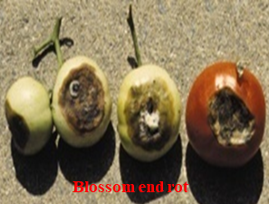
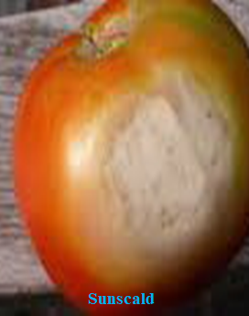
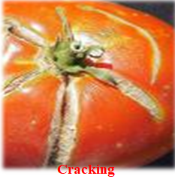
Physiological Disorders:
  Blossom end rot (caused by ca deficiency & water stress),
  Blotchy ripening or sun blotch/sunscald (K deficiency or excess N),
  Fruit crack (abundant rainfall and high temperature)

Slide 32
Harvesting and postharvest handling
Yield: - 10-15ton/ha in Ethiopia and 25-50ton/ha in other country (hybrids).
Harvesting
  Depending on cultivars, fruits could be ready for harvest at about 75-90 days after transplanting. The stage of maturity at which tomato fruit are picked/harvested depends on:
    The purpose for which they are grown (fresh or processing)
    The distance they are transported from production to retailer or consumers; and
    Availability of storage facility

Slide 33
  There are six stages of harvesting ripeness
    Green mature stage: Surface is completely green
    Breaker- pink or red up to 10%
    Turning stage: 10-30% red or pink (Fresh market better be harvested.
    Pink sage: 30-60 of the surface shows pink color.
    Light red- 60-90%
    Red- More than 90 % red color- processing harvested

Slide 34
For long distance transport harvest the fruit at mature green or breaker stage.
For processing at full ripe stage (nearly all ripe but flesh is firm) are required
    to optimize various quality parameters such as color, flavor, texture, acidity, and total solids.
For road side sales harvest at breaker, pin stages on wards.

Slide 35
Storage:
  It is climacteric fruit that exhibits increase both in respiration and ethylene production. Therefore; Should be handled at low temperature Ripe (red) fruits 3-4 ºC and 85-90% RH
  Ethylene may be applied to accelerate ripening and to control the percentage of red-ripe fruits. optimum Tº for ripening is crucial (not <10 ºc)
Other post harvest handling practice are done after harvest; but always avoid damage during handling process

Slide 36
B. Pepper (Capsicum species)
Use and composition
The world’s third most important vegetable after potatoes & tomatoes
Are major ingredients of curry powder (for flavoring, coloring food & pungency).
Used as a Coloring agent by extracting the oleoresin & pharmaceutical ingredient

Slide 37
Consumed pod as fresh (salads as vegetable) in raw or cooked with other dishes (added to stew as a spice, sandwiches or hamburgers)
A rich source of vitamin A, C & E, minerals (K, P & Ca)
Prevents heart diseases by dilating blood vessels
Processed into d/t forms (sauces & dried powered, pickles) & assists in digestion

Slide 38
Origin and Botany
Originated in Latin America (Peru, Chile, Bolivia)
Perennial herbaceous usually grown
  As annual plant for its fruit (short duration crop)
  which are found in Solanaceae family.

Slide 39
The genus Capsicum which consists of 22 wild species and five domesticated species
  Capsicum annuum (it includes hot pepper, bell/sweet paper)-it is the most commonly cultivated one.
  Capsicum frutescens (chili pepper; contain very hot types, mitmita or very hot Berbere)
  Capsicum chinense
  Capsicum baccatum
  Capsicum pubescens
Among the five species grown on the world the two important types grown in Ethiopia are: Hot pepper and Sweet pepper

Slide 40
Hot pepper because of its extensive use in the Ethiopian diet, the chilly is an important traditional crop.
  It is used industrially in the dry state for production of color oleoresins by a solvent extraction process.
  It has high content of capsaicin which makes the fruit very pungent and
  Fruit size is relatively small than sweet type; while sweet pepper has a very low content of capsaicin.
In Ethiopia, sweet pepper is only produced for fresh export to Europe.

Slide 41
They are Both cross-pollinated and self-pollinated plant
Pepper fruits vary in their pungency, color (yellow, green red), shape, flavor, size and their use
The pungent material found in all capsicum species is known as capsaicin (C₁₈H₂₇NO₃)
Carotenoids control pod color (red color comes from the carotenoids capsanthin and capsorubin, while yellow to orange color is from beta-carotene and violaxanthin.

Slide 42
Climatic and soil requirements
Climate
Warm season crop/requires frost free season as like tomato & egg plant/ grown in tropical & subtropical environment
A day T°C ranging from 24- 30°C is ideal for pepper.
A warm humid climate favors growth while dry weather enhances fruit maturity.
T°C above 32°C reduce pollination, fruit set, yield & increase transpiration.
T°C below 10°C fruit set failure (during flowering)

Slide 43
Small-fruited pungent peppers are more tolerant to high T°C on fruit set problems than bell type peppers
RF:- 600-1200mm that are well distributed over the growing season.
  Excessive RF affect flowering & fruit set, encourage fruit rot and decay, Phytophthora and root-rotting organisms.
  Water deficit may also result in bud and flower abscission, fruit split, small fruit etc…
It adapts best to an altitude 1000-1800 m.a.s.l

Slide 44
Soil
An ideal medium for growing pepper is fertile, a sandy loamy soil rich in lime, good in drainage, 30-45cm depth, pH5-7.5; all most similar to tomato soil requirement.
Still it can be grown in variety of soils provided they are well drained and rich in OM. Pepper is moderately tolerant to acidity.
Varieties
Pepper varieties are also differ in: Leaf type, Foliage coverage, Fruit set, pod size, Pod shape, Pod color & Response to various stress and growth conditions

Slide 45
Some of the hot pepper varieties grown in Ethiopia include:
  Bako local & Oda haro ( released by Bako ARC), Dube medium and Dube short ( from Jimma Agricultural research center) & Mareko fana, Melka zala, Melka shote, Melka awaze & Melka dima (from MARC)
Melka shote and melka dima are paprika (mild in capsaicin content- the group paprika contains less than 0.1% of capsaicinoids while the chillies contain from 0.1 to 1.4%) type mostly used for processing industries
The most popular variety of Sweet pepper is California wonder, which yields 10-15t/ha

Slide 46
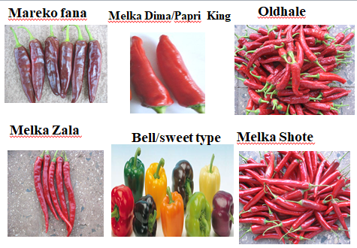

Slide 47
Cultural practices/agronomy of pepper
Nursery management
  Site selection: Available water, good soil & free water logging conditions, field not used for related crops in the previous 2-3 seasons.
  Seedbed preparation: can be raise, sunken or flat depending on climatic conditions, the size of seedbed should be 1m width and 5 or 10m length.
  Seeding rate: 800-900g/ha, (95% germination). Sow seeds in the row at 15 cm row spacing at 0.5-1 cm depth; Thin seedlings to 3-5 cm spacing in nursery for best growth.

Slide 48
  Mulching - the whole bed with dry grass for 20 days
  Fertilizer: Use 5 kg farmyard manure or 100g/Urea/bed.
  Watering: the seedbed early morning or late in the after noon as needed
  Disease and insect control: by rotation, and cleaning and chemical treatment
  Stage of transplanting: When seedlings reaches to
    20-25cm height and having 5-6 true leaves or 45-60 days old

Slide 49
Recommended field management practices
  Land Preparation- the land is ploughed 3-4 times to get a fine tilth. FYM is incorporated during the last ploughing. For irrigated crop, ridges and furrows are made.
  Plant spacing: 70 X 30 cm (Melkassa agricultural recerch center) or 60 x 40cm (Bako Agricultural research centre) ; planted in June if it grown under rain fed & at any time under irrigation condition
  Fertilizer: 200 kg/ha DAP & 100 kg/ha Urea, 50% of urea applied at time of transplanting & the other half months after transplanting & also 10-20 tons of FYM/ha are applied.

Slide 50
  Crop Rotation: Like eggplant & tomatoes, peppers are also susceptible to many soil borne diseases. Therefore a period of 2 to 3 years elapse b/n successive pepper crop or other solanaceous crops is recommended.
  Irrigation: the crop is irrigated immediately after transplanting & thereafter at weekly intervals. Uniform soil moisture is essential to blossom and prevent fruit drop.
    Sweet pepper crops susceptible to diseases, which develop under water logged soil conditions.
      It is, therefore, necessary that seedling should always be planted on top of the ridge and about 10 cm away from the edge; are therefore avoid over application of water

Slide 51
  Weeding: Two to three weeding and mulching are necessary to keep the field clear of weeds.
Diseases and pests:
  Diseases: powdery mildew, anthracnose, dieback, root rots are major problems.
  Pests include: thrips, aphids, mites and whiteflies.
  Therefore; it should be controlled using different methods
Physiological disorders- Sunscald, Blossom end rot, Poor pepper color, Misshaped fruit.

Slide 52
Harvesting and Postharvest handling
Harvesting
The stage of maturity at which chilies are picked depends on the type/the purpose for which they are grown.
  Chilies which are used as vegetables are generally picked while they are fully grown but still green. Green fruits are picked at intervals (once a week or twice) that stimulate further flowering and fruit set.
  Those used for pickles are picked either green or ripe (Red chilies are harvested in three to four pickings, when they are fully shriveled red, 80-90 days after transplanting)

Slide 53
  Chilies used for drying (dry chilies) are picked when red and fully ripe (When fully or partly dried on the plant).
Note: depending to the varieties it reach to maturity 80-90 days after transplanting
Chili crop takes 40 and more days to flower after transplanting and a further 30 days to develop fruit suitable for green harvest.
Sweet pepper is harvested when the fruits have reached full size but are still green. Harvesting frequency is usually once weekly

Slide 54
The duration of the harvest for fresh market is about 5-7 times (30 to 40 days) While it is 3-5 times (15 to 20 days) for processing type
Drying
On harvesting, chillies have
  a moisture content of 65-80% &
  this must be reduced to 10%.
    This could be achieved by sun-drying the fruits.
      Pepper fruits used for dried purpose are is harvested when they are fully ripe

Slide 55
Four/for uniform drying the harvested fruit;
  first must be curried and
  then further drying is possible by sun.
    Dried chilies can be produced by sun drying on trays or mats at table height, not on the ground.
Over drying causes the fruit to become brittle and easily broken.
  Breakage of the fruit is not important in chillies to be used for solvent extraction of oleoresin.
A higher price is sometimes paid for fruit from which the seeds have been extracted b/c of having high capsaicin content.

Slide 56
Storage
Under small-scale local condition, it can be stored with the pod under shade or in cool and airy conditions till the next planting season.
However, under commercial condition, the seed could be dried to low moisture (7-8%) and stored under cool conditions in bags or in vapor-proof containers.
Sweet pepper may be waxed to reduce moisture loss. It is stored cool at 10⁰c & 90 -95% RH for a period of 2-3 weeks.
At the time of packing before storage, the cut end of the stalk may be dusted with sulphur as a protection against decay.

Slide 57
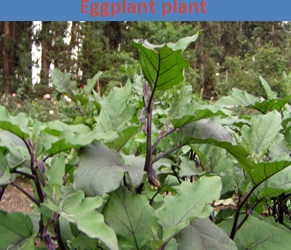
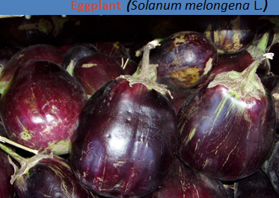
3. Egg plant (Solanum melongena)

Slide 58
  7.2. Bulb Vegetable
    Bulb groups consists of a wide range of underground modified leaves vegetables like Onions, garlic, leek (Allium porrum), shallot (Allium cepa var. aggregatum ).
    They are the members of genus Allium, which is tropically well adapted to suit different ecosystems.
    Among the bulb crops, onion and garlic are the most important vegetables, extensively grown in the tropics.
Belong to the family Alliaceae; Indigenous to the area from Palestine and India

Slide 59
A. Onion (Allium cepa var. cepa)
Use and composition
  One of the oldest vegetable known to man, it is popular world wide which are easily propagate by seed than others
  It is used for its distinctive pungent flavor caused by methyl propyl sulphide & used for seasoning the cooked foods.
  Onion bulb is rich in P, Ca, Fe minerals & carbohydrate & it contains also protein, vitamin C, riboflavin, thiamine & fiber

Slide 60
  The green leaves and mature and immature bulbs are either eaten raw/salad or for the preparation of vegetables and
  Onions are also used in soups, sauces and for seasoning foods
  Dehydrated and onion powder are used
  Also used as a Medicinal value & ornamental use

Slide 61
Origin and botany
  Originated in central Asia, possibly in the Iran & West Pakistan
  Family: Alliaceae, genus: Allium and species: cepa and sub species: cepa
  Chromosome number: 2n=16
  It is a biennial herb, normally grown for its bulb as annual. inflorescence appears after vernalization in the 2nd season
  It has a single bulb formed from thickened leaf bases (food storage leaves)
  Bulb colors are variable (red, yellow, white and brown)
  It has hallow leaves
  has psudostem formed by sheath leaf bases (older leaves)

Slide 62
Climatic and soil requirements
Onion is a biennial crop & takes two full seasons to produce seeds.
The optimum growing temperature lies b/n 15 ⁰C- 23 ⁰C
It is a relatively cool season crop, especially for the development of vegetative part prior to the onset of bulbs formation. Bulbs normally form at relatively high T ⁰C
Cool period is required after bulb formation for the initiation of inflorescences and flower stalk.

Slide 63
Bolting (seed production) is favored by
  cool and short day condition
While bulbing is favored
  by warm and long day (14-16 hrs of day light ) condition for most varieties.
Onions will bolt if exposed to a prolonged cold period following a favorable growing period.
  This results in small bulbs with large necks which are hard to cure and generally unusable.

Slide 64
A change from vegetative growth to bulb formation is stimulated by T ⁰C variation (cool to warm).
  This is related to the production of an auxin hormone
    which inhibits leaf formation, the produced food being diverted to the development of the bulb
Onion can be grown during the rainy season but the later part of the growing period should be dry. However, incidence of diseases may cause a considerable reduction in yield.

Slide 65
According to MoARD (2007), the optimum altitude range for onion production is between 700 and 2200 m.a.s.l.
  At lower altitudes, production should be restricted to the cooler months of the year.
  At higher altitudes the crop takes longer to mature
Soil requirements:
  A fertile, well-drained, sandy loamy soil with plenty of organic matter is best for growing quality onions.
  Clay soils restrict bulb development and often produce a hotter onion, while sandy soils require more fertilizer and water than loamy soils.
  The ideal pH is b/n 5.5 and 7

Slide 66
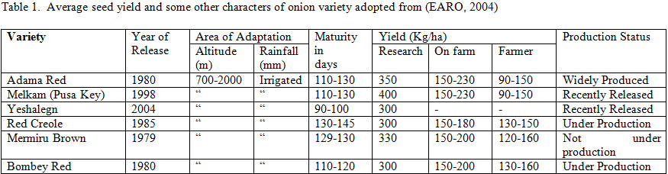
Varieties

Slide 67
Agronomy/cultural practices
Nursery management practices
  According to EARO (2004), the following nursery management should be practiced while transplanting:
    Site selection- Available water, good soil and free of water logging conditions, clean field that are not used for related crops in the previous 2 -3 seasons.
    Seed bed preparation- The bed could be raised, sunken or flat depending on the climatic conditions.
    Fertilizer: well decomposed farmyard manure or 100 g Urea/5 m²

Slide 68
    Seeding rate: 3-4 Kg/ha, 95% germinations, sowing spacing are 5-7cm distances.
    Mulching material: Dry grass for 15 days (removed after germination)
    Watering: water the seedbed early in morning and evening, as required
    Diseases: Bacterial and fungus are common diseases, rotation, and chemical treatment could be applied

Slide 69
    Stage of transplanting: Seedling of 13-15 height or 45-55 days old.
    Weeding: Weed pressure can be especially damaging to young onion plants because
      they are slow growing,
      have shallow roots and
      do not have enough foliage to adequately shade the ground.

Slide 70
Field management practices
Transplanting's are planted in well prepared land at the beginning of rainy season
Mulching with dry grass and irrigation immediately after transplanting is recommended.

Slide 71
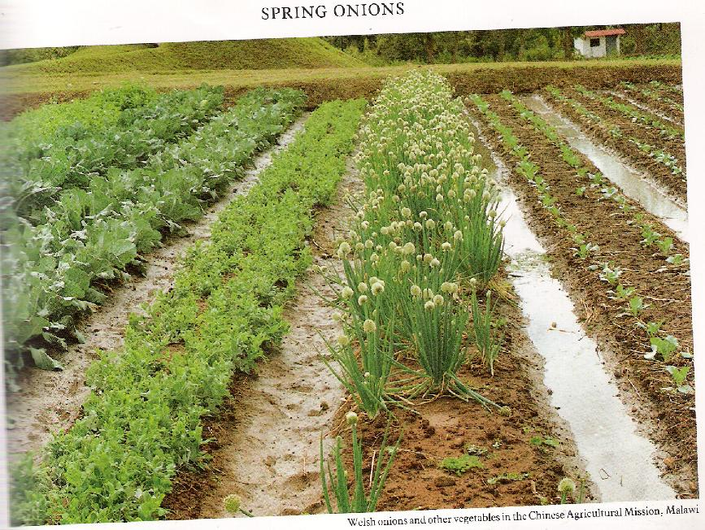
Plant spacing:
  Generally the recommended planting system for hand cultivation at Malkassa, during transplanting were flat top ridges with furrows 40 cm, on the flat ridges of 20 cm a part b/n rows and 10 cm spacing within the row (40 x 20x 10cm, two rows/bed). A distance of at least 1000 m should isolate crops for seed production due to it is largely cross-pollinated plant.

Slide 72
Fertilizer:
  100 kg/ha DAP & 150 Kg urea applied (50% of urea applied at time of transplanting & the other 50% at one & a half month after transplanting). High N delays bulbing
Irrigation:
  Applied every 4-5 days b/c of shallow rooted plant for the first 4 weeks and every 7 days then after.
  Irrigation should be stopped before the bulbs have reached their full size to promote the ripening process.
  If irrigation is continued too long, the proportion of thick-necked and split bulbs is likely to be higher and the keeping quality of the crop may be impaired.
    A long dry period is required for bulb ripening after the leaves have withered.

Slide 73
Weed control- Onions are very poor competitors of weeds. Thus, weeds have to be removed on time. Onion is very sensitive especially in the first 6 weeks b/n 26-60 days after transplanting. Control could be by proper field selection, cultivation & chemical application. Timely shallow cultivation is used to destroy weeds
Disease and insect pest affecting onion crop includes:
  Purple Blotch (Alternaria porri), Fusarium Basal Rot, Downy Mildew (Peronospora destructor) and Bacterial Soft Rot and Insect pest like Thrips (Thrips tabaci) are common. During rainy periods (high humidity) may suffer severely from downy mildew & purple blotch
  Chemical and cultural management to control the diseases and insect pests affecting onion production.

Slide 74
Harvesting and post harvest handling
Harvest bulb onions when about
  Three fourths of the tops have fallen (50-75% of the leaves fall down) over before the leaves dry down completely.
    Bulbs left in the ground until the tops are dead may develop roots, resulting in low quality onions.
  The development of red pigment & the characteristics pungency of the variety are also considered important indices of harvest maturity.

Slide 75
Remove tops by cutting 1 to 1½ inches above the top of the bulb.
Then; bulbs are properly cured (air dried in the field of shaded area for about 5 days till foliage dry before stored or distributed).
  Care is necessary to prevent sun scorch by covering the bulbs with the leaves of next row (outer covering);
Tops should not be removed until necks are dry.
Roots should be trimmed as close as possible to the bulb but tops should be trimmed to a length of about 2.5 cm.

Slide 76
After harvesting, onions are topped and cured under shade for a period of 3-4 weeks or longer depending on weather condition before they are stored.
Curing for 10-12 days in shade helps in
  development of more number of skin and
  also their retention for longer period.
    Properly cured onion bulbs could be stored for 2-3 months.

Slide 77
Purpose of curing (drying) is
  The removal of excess moisture from the outer skin and neck of onion which helps in reducing the infection of diseases.
  Helps minimizing shrinkage due to removal of moisture from the interior and
  Aiding the development of skin color and to remove field heat before bulbs are stored. Therefore, onion should be adequately cured.

Slide 78
Onion storage
Cured onions are suitable for storage. Rapid development of rot diseases and pre-mature sprouting can be expected in improperly cured crops.
Onions are best stored in loose stacks, up to 50cm deep with good ventilation.
Size grading and elimination of defective bulbs should be done before storage.

Slide 79
The store should be sited where there is good air movement for ventilation.
A suitable design under Ethiopian condition consists of an iron roof supported on upright poles and open on all sides.
The floor is raised 50 cm above soil level and is constructed of poles. This allow for ventilation beneath and through the stacks of onions.

Slide 80
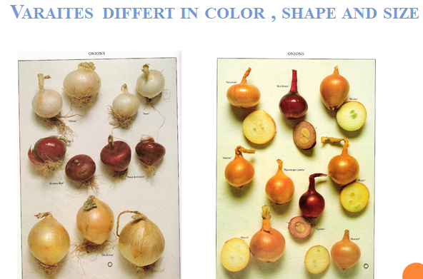
Sprouting- due to high humidity & low Tº in storage (spraying maleic hydrazide & beta irradiation inhibit sprouting and helps export products to be stayed for 60-80 days & application of isopropyl phenyl carbamate (CLPC) + methyl naphthalene acetate (MNA) entirely suppressed sprouting at 12 to 18◦c for 6 months).

Slide 81
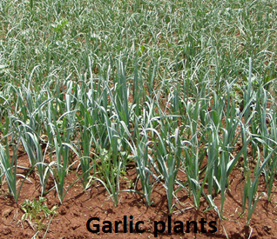
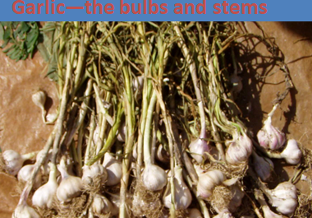
B. Garlic (Allium sativum L)

Slide 82
Origin and botany
Originated in central Asia
It is annual plant for bulb production and
Biennial for seed production that belongs to the family Alliaceae
It has an aggregate of bulbs/cloves each with outer protective sheathing scales.
Bulbs may contain 5-20 cloves depending on variety.

Slide 83
Use and composition
Garlic is used as spice and condiment in most Ethiopian cuisine/cooking
Garlic has high nutritive value than other bulb crops
It has been considered as a rich source of carbohydrate, proteins and phosphorus, dially disulphide, allicin, alliin
Medicinal properties like: Common cold prevention, Heart disease prevention, Antiseptic, Antimicrobial activities, Insect repellant, Strength immune system, Antioxidant effects, Anti-coagulation effects , Reduce high cholesterol & Hypertension

Slide 84
In china: garlic and tea has long been recommended for fever, headache and cholera
In Japan: soup containing garlic is used as remedy for the common cold with headache, fever and sort throat
Roman through World War I: garlic was used to prevent wound infection.
Garlic was regard as Russian penicillin during World War II.

Slide 85
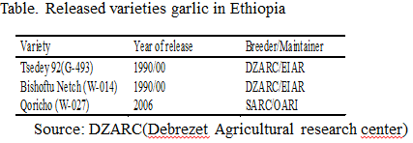
Varieties

Slide 86
Climatic and soil requirements
Adapted to cool climates that withstands moderate frost.
It is frost hardy plant requiring cool & moist period during growth & relatively dry period during maturity of bulbs.
RF- 600-700mm during the growing period (4.5-6 months).
The optimum T⁰C for growth is 12-24⁰C & Cloves cease growth under high Tº (> 25ºc).

Slide 87
Bulbing takes place during longer days & high T⁰C &
Exposure to low T⁰C in early stage favor vegetative growth & bulbing. Adequate vegetative growth promotes bulb formation.
It tolerate partial shade & grow in 500-2000 m. a.s.l in general & 1100-2000 m. a. s. l in Eth. is suitable for garlic
Grow best in a rich in OM, deep, well drained sandy loam to clay loam with a pH of 6-8. Heavier clay soils should be avoided as bulbs may become misshapen & harder to dig.

Slide 88
Agronomy/cultural practices
Land preparation: well prepared field that was not used for related crops in the last 2-3 seasons.
Seeding rate:
  vegetatively propagated using cloves produced by breaking up the bulbs &
  8-10 Qt/ha bulb with clove size of 1.50- 2.50 g are required for planting

Slide 89
Clove Preparation for Planting:
  Garlic seed stock should be stored as whole bulbs before planting, since cloves separated from the parent bulb deteriorate more rapidly than whole bulbs.
  Break/crack apart the bulbs just prior to planting. Dry bulbs are more easily broken apart into cloves than damp bulbs.
  Any damaged or diseased cloves should not be planted.
  Harvesting very mature bulbs increases the ease of clove separation prior to planting. Planting larger cloves of the same strain of garlic will produce larger bulbs than smaller cloves.

Slide 90
Plant spacing and Planting time:-
  30cmx10cm with 5-8 cm deep;
  planted at the beginning of the rainy period (June to July) & If irrigated at any time of the year.
Weeding and cultivation: every 10-15days
Fertilizer: 200kg/ha DAP & 150kg/ha of Urea (50% at the time of transplanting & 50% a half month after transplanting).
Irrigation- During the dry periods at weekly intervals; Longer interval necessary on heavy soils

Slide 91
Mulching:
  with clean straw or other immediately after planting in climates with very hard frosts.
  If you live in warmer areas, it is good to mulch after the ground gets cold, so that the cloves will experience their required chilling vernalization period.
Disease & insect pest-
  Fusarium basal rot, Pencillium, Powdery mildew, Purple blotch, Botrytis &
  Pests (Cut worms)

Slide 92
Harvesting and post harvest handling
Garlic will be ready to harvest
  when the leaves begin to yellow (going to die- 50-75% of the leaves fall down) in early summer.
Lift up the entire plant by hand or with a spading fork, being careful
  not to bruise the bulbs & brush off the soil but do not wash the bulbs.
If harvesting is delayed, the bulbs be attacked by a black mould w/h spoils their appearance & considerably reduces the value

Slide 93
Bulbs are properly dried/cured in the field before stored or distributed (EARO, 2004)
  Cure in a warm, shady place with good air movement.
  Garlic needs to cure/dry for at least 10 to 14 days. The neck cells constrict and hold the juice in the bulb. After a couple of weeks they may be clipped off, leaving ¼ to ½ inch of the stem and roots
  Allow bulbs to dry until the neck is dry and the outer skin is papery, approximately two to three weeks. Then garlic is ready for storage or sale. It can be stored in clean onion bags. Garlic will lose up to 20 percent of its weight in the curing process.

Slide 94
The whole crop be also sun dried & then leaves & roots trimmed off as recommended for onion
The clean bulbs (Remove tops when dry) should be stored
  Under a well-ventilated,cool & dry area for 6-8 months for most of the varieties.
  It can be store by braiding or tying several heads together & hanging up or by cutting tops off and placing bulbs in a mesh bag.

Slide 95
  Garlic stores well up to 180 or more days if held at 0ºc & RH < 60%.
  At TºC of 4.5ºC or higher garlic begins to sprout; regardless of Tº, if the RH is 70% or higher, it quickly becomes moldy (Penicillin mould ) & initiates roots
  Garlic stored for planting should be maintained b/n 5ºC & 10ºC, not < 4ºC or > 18ºC. Storage life under appropriate conditions is 5 - 8 months depending upon the strain of garlic.

Slide 96
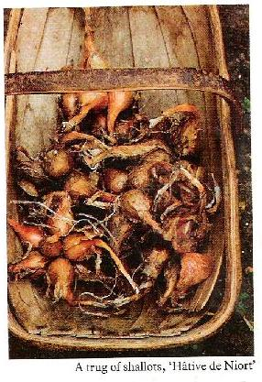
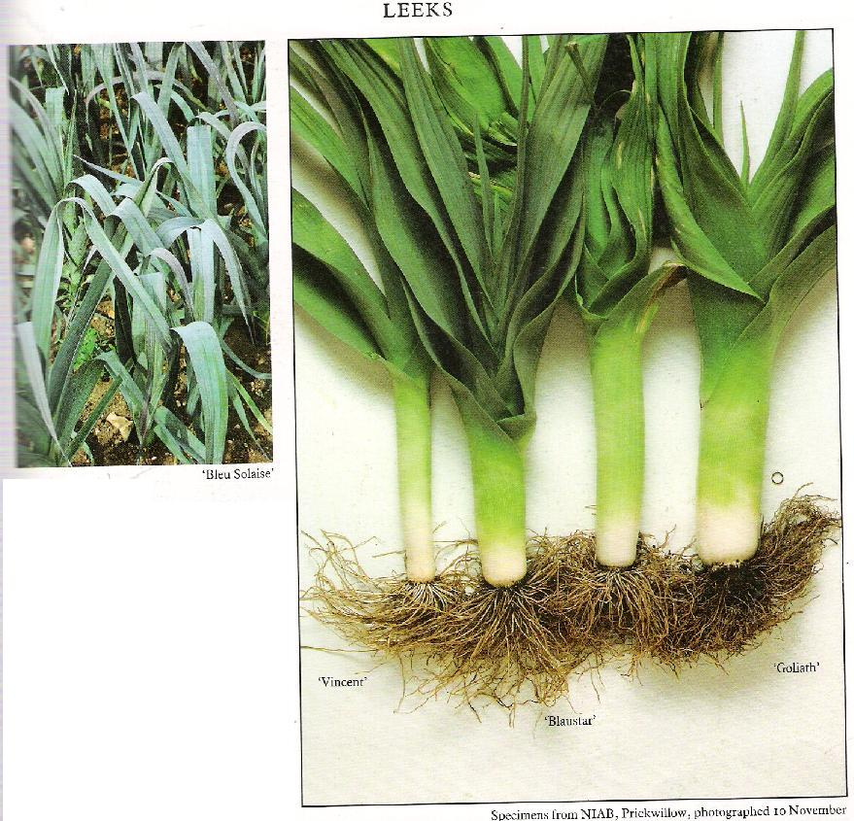
Shallot
(Allium cepa var. aggregatum or Allium ascalosum)
Leek
(Allium ampeloprasum var. porrum, a. porrum)

Slide 97
  7.3. Leafy vegetables
The followings vegetables are included under leafy vegetables:
  Cabbage, lettuce, Spinach, Kale, Collard, Chinese cabbage, Parsley,
  The part of plant to be used for consumption is its leaf part

Slide 98
Cabbage(Brassica oleracea var. capitata)
Origin –
Eastern Mediterranean & Asian minor
Botany
  Crops belongs to the family cruciferae (brassicaceae)
  Is biennial plant grown as an annual
  Initially it develops rosettes until basic leaves form
  Forms compact head & its shape may be pointed

Slide 99
  Leaf color and shape are variable
  Do have fleshy tap roots
  Terminal bud grow forming over increasing overlap of that eventually become the head
Uses and composition
  It is the most important vegetable grown in Ethiopia which is commonly used as boiled vegetable or cooked in curries.
  Raw in salads, chopped, dehydrated to be used in soups

Slide 100
  Main dishes with meat
  Cabbage is known to possess medicinal properties. In ancient times, it was used against ailments like gout, diarrhea, stomach and coeliac troubles.
  Cabbage has an anti-cancer property, it protects against bowel cancer due to presence of indol- 3-carbinol.
  Provide alkaline reaction/ ideal roughage aids digestion
  Cabbage is rich in mineral content especially ca, fe and P and vitamins (A, B and C).

Slide 101
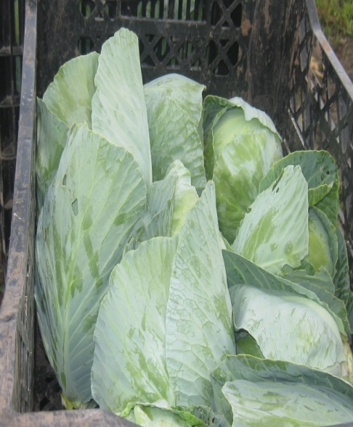
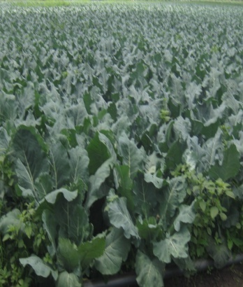
Cultivars
In cabbage, varieties being grown in Ethiopia are introduced ones as packed seeds from d/t countries and research was not extensively done on varietal improvement in this crop.
Early drum head and Copenhagen market are few of such varieties currently popular among growers

Slide 102
Climatic and soil requirements
  It is a biennial crop for seed production. In the first season heads are produced & in the following season seed production follows.
  Cabbages are cool season crop that grow best under cool moist conditions area (hardy plant that can tolerate severe frost) of an altitude > 800m.a.s.l &
  Optimum TºC range is 15º- 20ºC; above 25ºC growth is arrested. Head formation is more to occur at TºC lower than 24ºC.
  A difference of 5ºC b/n day & night TºC is appearing to be necessary for adequate head formation.

Slide 103
  It requires a dormant period of cool TºC to bolt & initiate seed stalks & flowers. Headed plants form seed stalks when exposed to mean TºC of about 5⁰c for 6-8 weeks.
  Cabbage will grow on most types of soils but are best suited to a well-drained loam/sandy loam with a good organic status & A pH of 6.5 - 6.8.
  However, they doesn’t grow well on a highly acidic soils.
  Heavy clay soils may easily become waterlogged after heavy rain; thus encourage black rot & soft rot diseases .

Slide 104
Cultural practice/techniques:
Propagation- by seed
  Seeds are sown thinly in 1 cm deep furrows spaced 15 cm apart in nursery seedbeds and 300 grams of seed is adequate to plant 1ha of cabbage.
  Usually these furrows run across a seed bed which should be 1 meter wide.
Transplanting stage
Seedlings should be transplanted when
  they have developed 2pairs of true leaves & are about 12-15cm high (usually 4-5 weeks after sowing).

Slide 105
Spacing in the field
  A spacing of 50 cm x 40 cm or 40 cm x 40 cm is recommended for early maturing cultivars, while all others can be planted 50 cm x 50 cm apart.
  Spacing can also be varied depending on the
    head size required, narrow spacing for small heads & wider spacing for bigger heads.
Irrigation
  Regular watering is required throughout the growing period. Soil must be kept moist to a minimum depth of 45 cm.

Slide 106
  During the 1st week after transplanting it is critical that the soil is kept moist all the time especially in summer and on sandy soils.
  Seedlings should not be left to get dry at this stage because their roots are not yet fully developed hence, can only get water from a limited soil volume.
  The general water requirement for cabbage is 23.4 mm applied at intervals of 6 days and 2 days during winter and summer, respectively.

Slide 107
Fertilizer requirement
  Cabbages are heavy nutrient feeders. So that organic manure at the rate of 50 tons/ha are incorporated into the soil to a depth of 30-40 cm & NPK fertilizer should be applied.
  Cabbage responds very well to N (N is applied in top dressing at interval of 15 days until the heads begin to develop)
  Deficiency of B & Ca leads to Hollow Heart (head center cracking)
Disease and pest
  Alternaria leaf spot, Black leg fungus, Black rot, Cercospora leaf spot andClub rot mildew and Aphid, cabbage moth, cut worm, diamond back moth, etc

Slide 108
Harvesting and Storage
Harvesting
  The fully developed compact or firm heads are harvested before they start cracking or bursting.
    The firmness of heads can be observed by pressing the heads with fingers.
    If they are still small or loose heads should not harvested.
  The heads are cut when the head are firm & well sized with a knife attached with wrapper leaves.

Slide 109
  Once cabbage is mature, the heads will stand in the field from 2 (summer) to 4 weeks (winter) before splitting.
    However, some varieties are prone to splitting and cannot be left for such a long time.
  When harvesting, a few outside leaves on the head should be left to protect it during transport.
  Split, rotten and insect damaged heads should be removed before the crop is marketed.

Slide 110
  At low land conditions heads may be harvested in 70 - 90 days;
  At elevations over 1000 m it takes longer (80 - 110 days) depending on the cultivar.
  Individual mature heads should be harvested by severing just below the bottom leaves using sharp knife.
Storage:
  If stored at 0ºC and at high RH (95 - 98%) cabbage can be stored for 4 - 6 months.

Slide 111
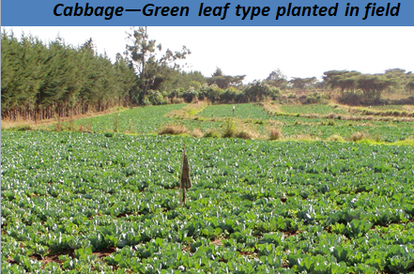
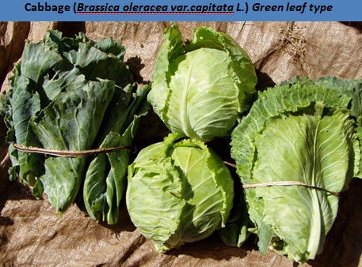
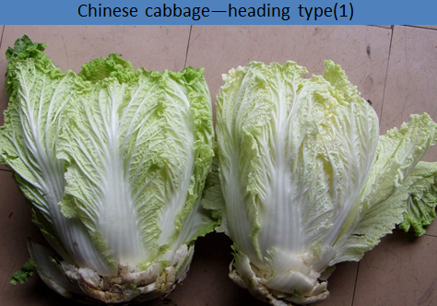
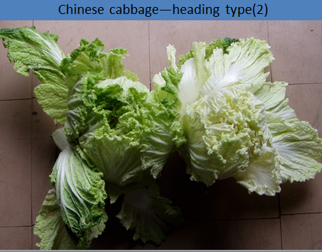

Slide 112
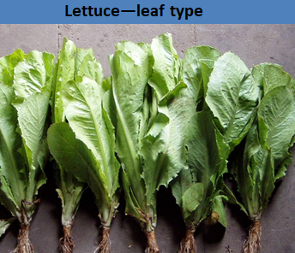
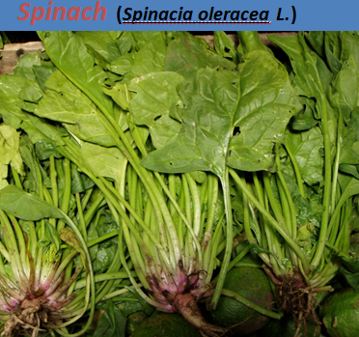
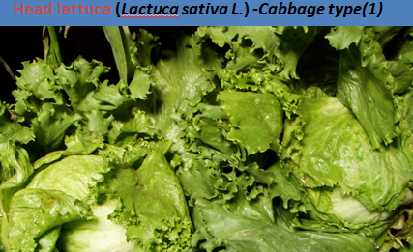
Others leafy vegetables
  Lettuce (Lactuca sativa L)
Spinach (Spinacia oleracea L.)

Slide 113
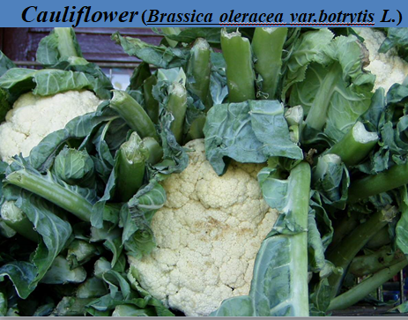
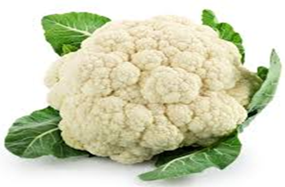
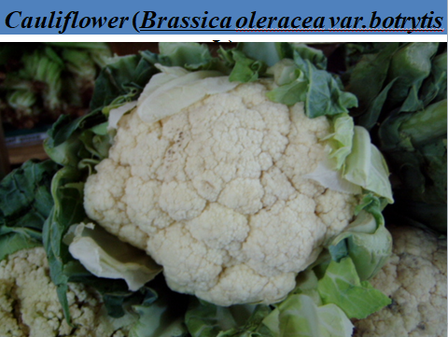
7.4. Flower vegetables
The edible part is
  its flower and
it includes- Broccoli, Cauliflower & artichoke
A. Cauliflower(Brassica oleracea L.var.botrytis L.)

Slide 114
Origin- Mediterranean region & Asian minor
Uses- raw in salads & with dips, best steamed in cheese sauce
Botany
  Biennial plant grown as an annual
  The edible portion is the flower head (curd)
  Has similar botanical feature with broccoli. Leaves are narrower, longer, and lighter colored than those of either cabbage or broccoli

Slide 115
Climatic and soil requirement
Thrives best in a cool moist season.
Generally it require Tº of 7-29ºC.
Prolonged cold TºC (4-14ºC) retard maturity of cauliflower.
Two groups based on TºC requirement
  Tropical adapted- form curds & flower in hot
  Late maturing– take long time to develop curds & req’r cool condition

Slide 116
Altitude= > 1000m.a.s.l
Soil=
  deep friable soil (not too light or heavy) with good OM content to enhance water holding capacity having pH of 6.0-7.5 have been found best.
Cultural practice
  Seeds are sown in nursery beds either direct or transplanted. Depending on the cultivar seedlings are transplanted at spacing of 45-60cm b/n plants & 60-75 b/n rows.

Slide 117
  Blanching - is the activity which involves shading the developing curd/head when curd begins to develop
    by tying the upper leaves over the curd
      to protect the head from Sunburn &
      to keep it from turning green & developing off-flavors.
  Fertilization similar to that of cabbage & depend on the soil fertility per ha.
  Irrigation - About 25.4-38.1mm of water every 5-7 days.

Slide 118
Disease and pest- Powdery mildew, black rot, downy mildew Stem rot, Damping off, Black rot, Club rot and Aphid, cabbage moth, cut worm, diamond back moth, etc
Physiological disorders- unfavorable conditions (hot weather, drought, too low temperature) can result in formation of premature heads or curds .
  Blindness is a physiological disorder in which no curds are formed.
      Blindness may be due to poor fertility, disease, insects and cool temperatures.

Slide 119
Harvesting & storage
  Harvesting
    Harvested when curd is white /creamy white/blemish free head & When its firm & well sized
    It is ready for harvest when the head has grown 15-20cm in diameter, 50-55 days (early season), 70-80 days (mid season) & >150 days (late season)
  Storage-
    0ºC & 95% RH ( stay for about 4-6 weeks)

Slide 120
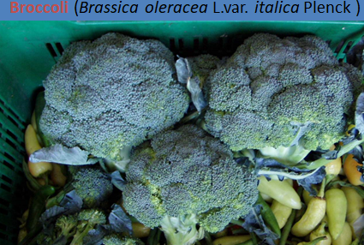
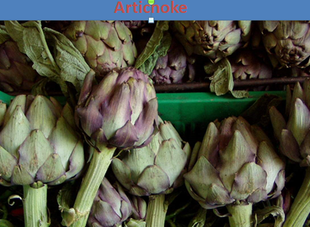
Others flower crops

Slide 121
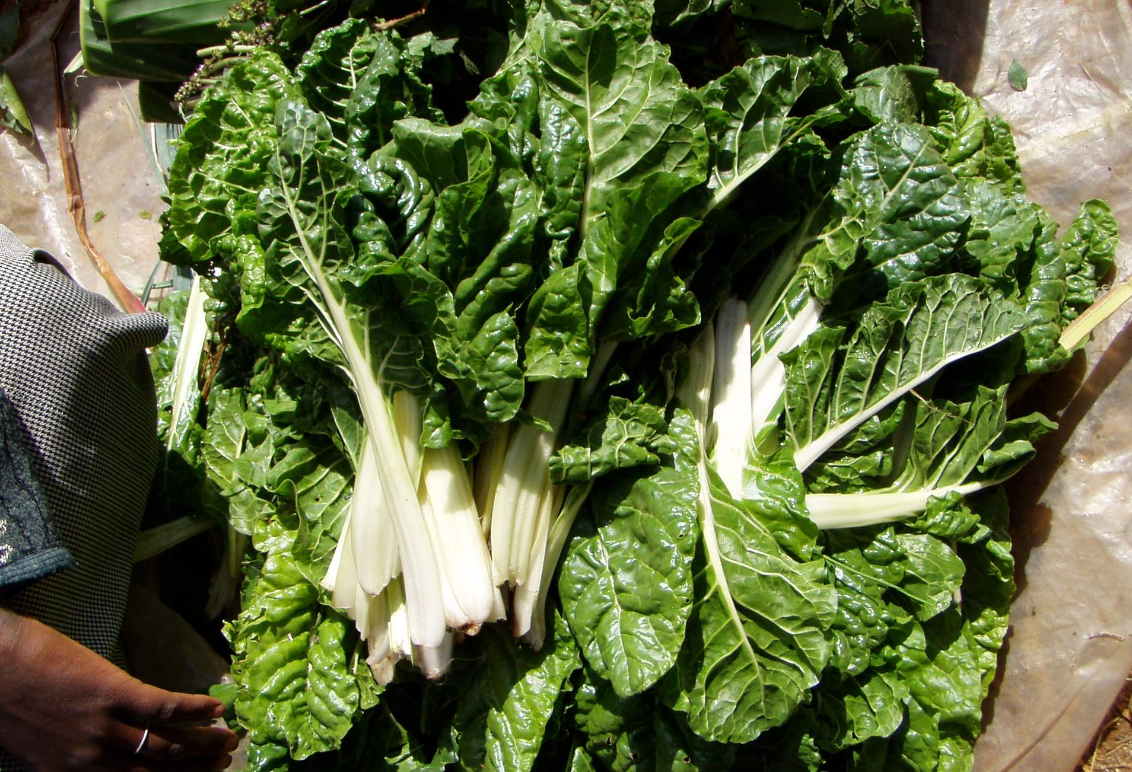
7.5. Stem/petiole vegetables
It includes: Swiss chard, Celery and asparagus
Swiss chard (Bata vulgaris var. cicla)

Slide 122
Origin - Mediterranean basin
Botany –
  It is a member of Chenopodiaceae (goose foot) family
  It is an herbaceous biennial, botanically very similar to beet; except that it does not form an enlarged hypocotyl.
  Swiss chard develops a compressed cluster of petioles (stalks) which may be white, red or pink similar to celery, forming distinctive enlarged petioles with heavy dark green savoyed leaves.

Slide 123
  The plant features and flowering habit are similar to the table beet but unlike beet, however, it does not respond to high temperatures, which cause bolting in beets, spinach, and lettuce, in the first year as well as subsequent years.
Uses-
  used as cooked product: the stems are used like cooked celery and for best flavor should be steamed.
  The leaves are cooked the same as spinach (with only the water on the leaves left from washing them).

Slide 124
Climatic and Soil Requirements
  Having the ability to resist high T⁰C by not bolting is a distinct merit. In order to induce flower stalk formation, chard roots must be exposed to extended periods of chilling.
  Moisture requirements for germination range from intermediate amounts to field capacity.
  A well-prepared, deep loamy soil high in organic matter will insure vigorous full-grown chard plants. The pH requirements range from 6.5-7.5.

Slide 125
Cultural Requirements
It can be direct seeded in the field and the seeds are planted at spacing of 10-15cm b/n plants & 50-70cm b/n rows. If plants seem to be crowded, they can be thinned to 15-30cm apart in the row.
Fertilization- the requirements for soil & fertilizers would approximate those suggested for beets or spinach (70-135 kg N/ha, 40 kg P/ha, 56 kg K/ha). Like beets, chard is tolerant of Mg deficiency.

Slide 126
Irrigation- Adequate watering is recommended for successive petiole production and to keep the leaves succulent and tender.
Diseases and Insects:- Down and powdery mildew. In Ethiopia, Thrips cause serious damage to chard. Use Malathion to control them.

Slide 127
Harvesting –
  The leaves should be cut regularly after they reach tender maturity usually
    50-60 days after planting.
  After the outer ring of petioles is cut new heart growth occurs and the outer petioles successively mature for continuous harvest. If the outer petioles are not harvested promptly, the expansion of new ones is inhibited.

Slide 128
Post harvest handling
  Petioles that are bright and blemish free are bundled together in bunches and quickly cooled to remove field heat and reduce respiration rate.
  Chard should be kept at a high RH of 90-95% held at 0 ⁰C. Under this it can be stored up to 10 days.

Slide 129
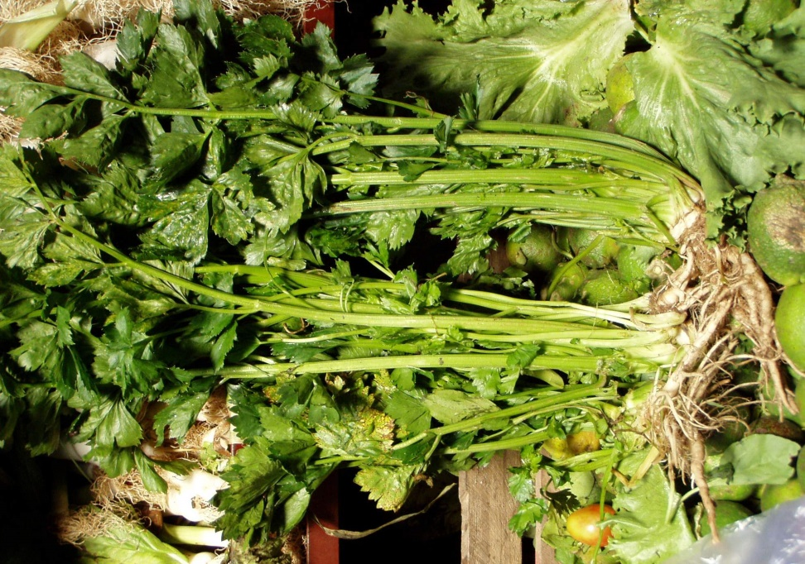
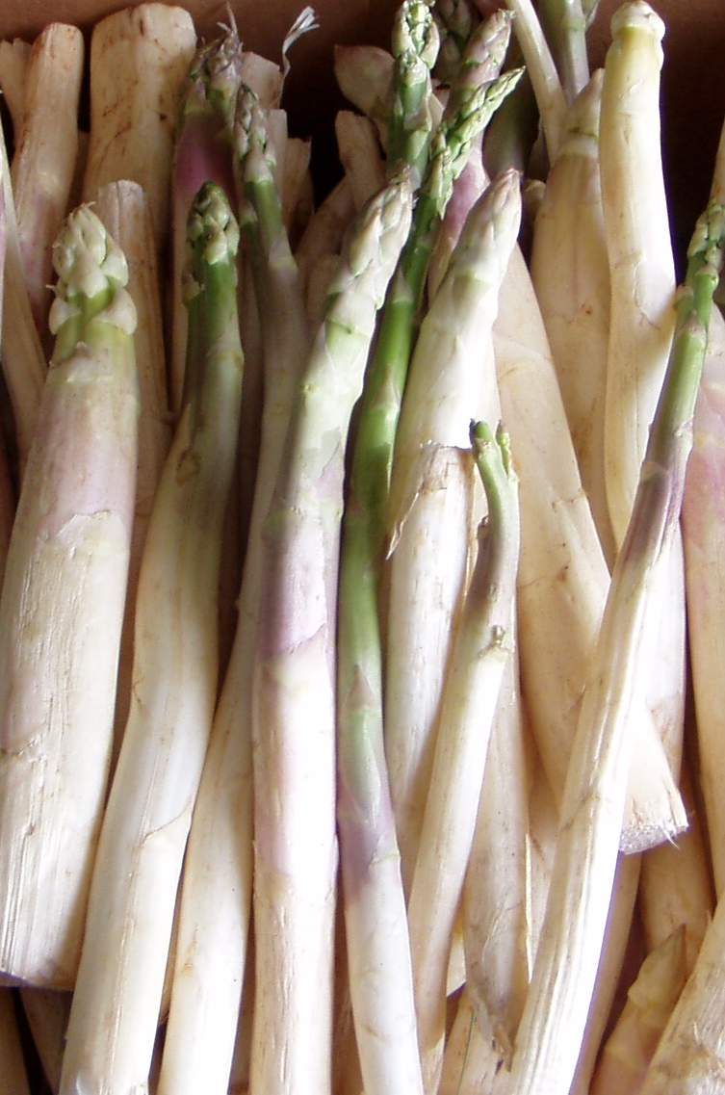
Celery (Apium graveolens L. var. dulce)
Asparagus (Artichoke officials)

Slide 130
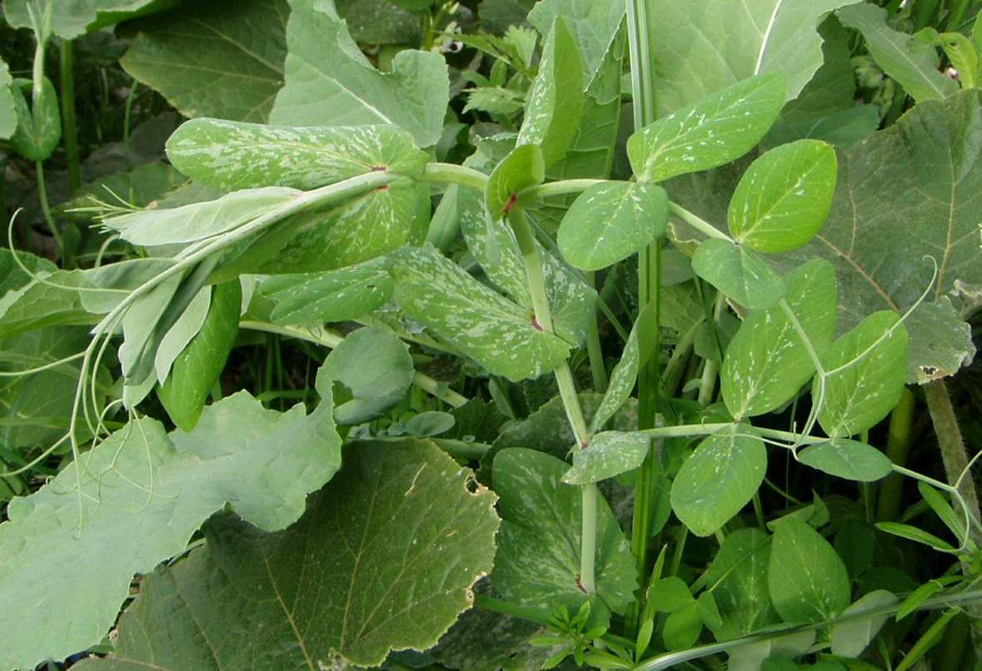
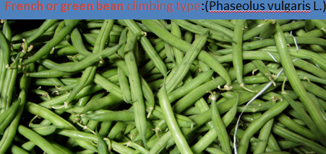
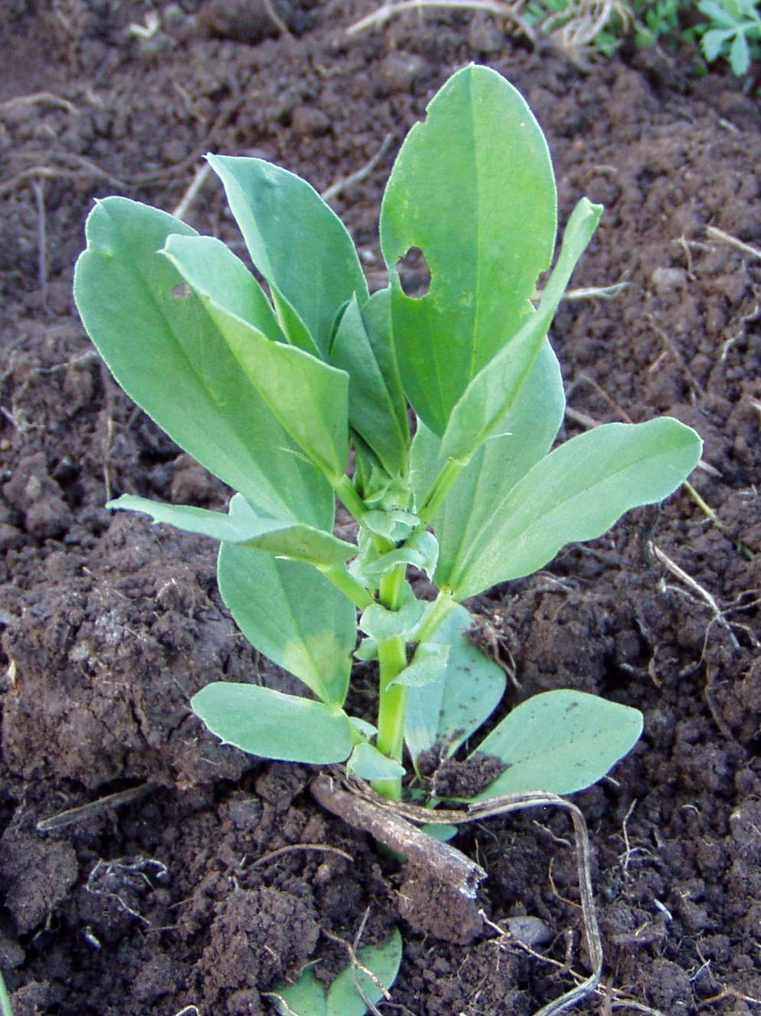
7.6. Leguminous végétales
Pea and Bean
French green bean

Slide 131
7.7. Cucurbit vegetables
  All cucurbitaceous vegetables have similar cultural practices. It includes Cucumber, Pumpkin, melon & squash etc..
Pumpkin (Cucurbita moschata)
It is annual vine crop belongs to the family Cucurbitaceae
Origin: Arid areas of central America
It is widely grown in Ethiopia mostly for home consumption. Commonly grown in the home garden.

Slide 132
The fruits of pumpkin are the largest in the group and usually eaten cooked.
However, individual fruit may weigh up to 15 kg.
Varieties:
Variety development programmes in pumpkin have not yet started in the country.
However, a lot of variations are found in fruit shape and size of local materials.
During 1961 and 1962, Mammoth Prize variety of pumpkin performed better than others (Mariam 1969).

Slide 133
Climate:
It is more adapted to warmer areas & T⁰C above 25⁰C are more favorable for growth & development. The cucurbita genus is sensitive to frost.
The cucurbits require comparatively dry warm and long growing season for seed production.
Soil:
Pumpkin grow best on well drained fertile soils with soil PH range 5.5. to 7.5.

Slide 134
Seed rate: 6-8kg/ha; Spacing: Row to row= 2.5-4.0 m & Plant to plant = 1.0 -1.5m .
Number of seeds sown/hill : 3-4
Harvesting:
  Harvesting of fruit for in pumpkin is done at the ripe stage
    when the color of the fruit change from green to whitish or yellow.
    When fruits become red and seeds inside the shell break readily from the pulp, then fruit is ready to harvest. Fruits are picked from plants and piled.

Slide 135
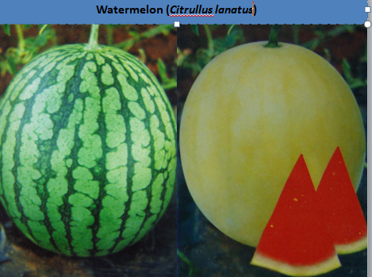
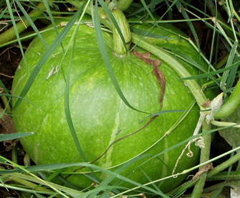
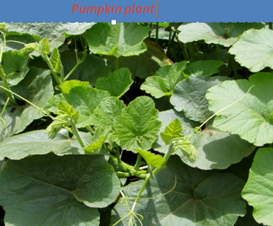

Pumpkin
Watermelon and Squash

Slide 136





Gourd
Cucumber & Muskmelon

